Slide 1
HADOOP SPARK-BASED REAL-TIME ONLINE SALES DATA ANALYSIS
Project By,
Meghana Bodapati ThirumalaNaidu ( 885206029 )
Pooja Honneshwari R ( 885237305 )

Slide 2
Table of Contents
Problem Statement
Aim of the project
Tools and Technologies used
Architecture
Approach
Dataset information
Kafka Streaming Screenshots
Processing Phase Screenshots
Future Scope
Conclusion

Slide 3
Problem Statement
Everyone in the modern world now follows the trend of online purchasing. E-commerce websites have made it easier for businesses to connect with clients, regardless of their location, interests, or preferences.
It's crucial to have an examination of solid sales data. Decision-making is aided, sales quality is maintained, and clients are better understood, all of which aids the enhancement of cross-platform advertising tactics.

Slide 4
Aim of the Project
The goal of this project is to gather sales information for goods sold across various platforms in several states. The outcome generated depicts the performance of each source in different states with corresponding sales of that product, which aids the enhancement of cross-platform advertising tactics.

Slide 5
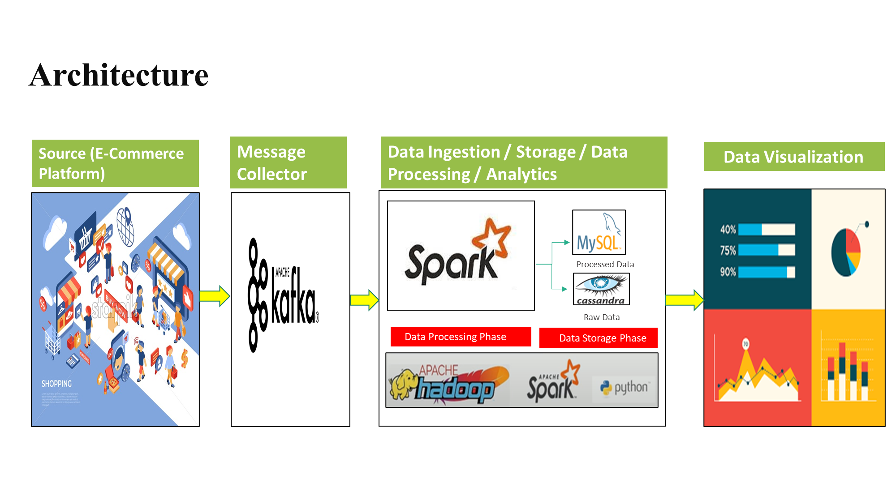
Architecture

Slide 6
Approach
Streaming data from various sources are directly inputted to kafka. Kafka is an open-source distributed stream-processing framework that collects this real-time data and stores it in Kafka-broker.
This stream of data is directed to the processing engine Spark, through Kafka-consumer which further processes and analyzes these streams of data.
The datastreams undergoes various processes such as Data injection, Data Storage, Data Processing, and Data Analysis.

Slide 7
Approach
The analysis results are stored in Mysql and the raw data is stored in Cassandra (because for further enhancement in the application,where-in we intend to add prediction models, data of any format can be stored as it is NO-SQL based database).
After analyzing, the visualization outcome is depicted in the Superset application.

Slide 8
Tools and Technologies used
Hadoop – open-source software utility used for storage and computation of data.
Kafka – used for capturing and storing streams of real-time data into categories called topics and later gives it to processing engine for analysis.
Spark – a data processing engine used for the collection of data-stream from Kafka and further storage, processing, and analyzing the data.
MySQL – is an open-source RDMS used to store the analyzed data.

Slide 9
Tools and Technologies used
Cassandra – NoSQL database management system used to store raw data.
Superset- an open-source software application for data exploration and data visualization.
Python (Anaconda, PyCharm) – The programming language used for the analysis.

Slide 10
Datasets Information
Three datasets are used for the analysis:
Customers dataset
Orders dataset
Products dataset

Slide 11
Dataset Attributes: customers.csv
ID
Name
Address
Birth Date
City
Created At
Email

Slide 12
Dataset Attributes: customers.csv
Latitude
Longitude
Password
Source
State
Zip

Slide 13
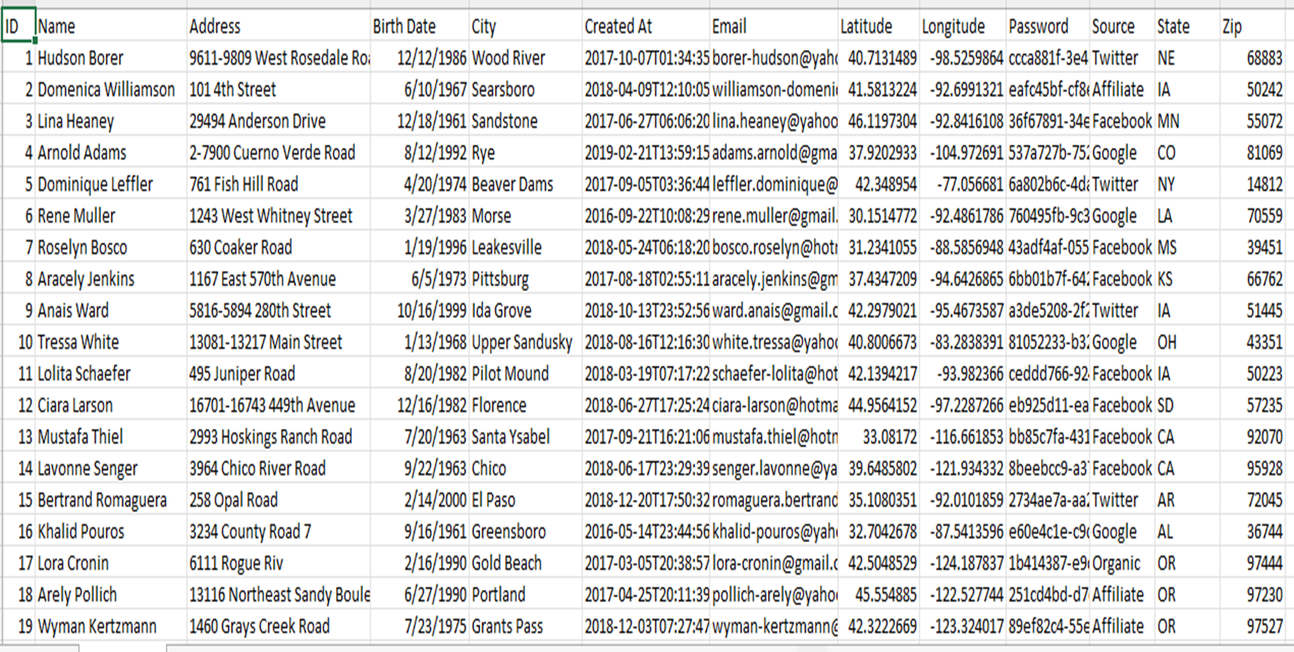
Dataset: customers.csv

Slide 14
Dataset Attributes: orders.csv
ID
Created At
Discount
Product ID
Quantity
Subtotal
Tax
Total
User Id

Slide 15
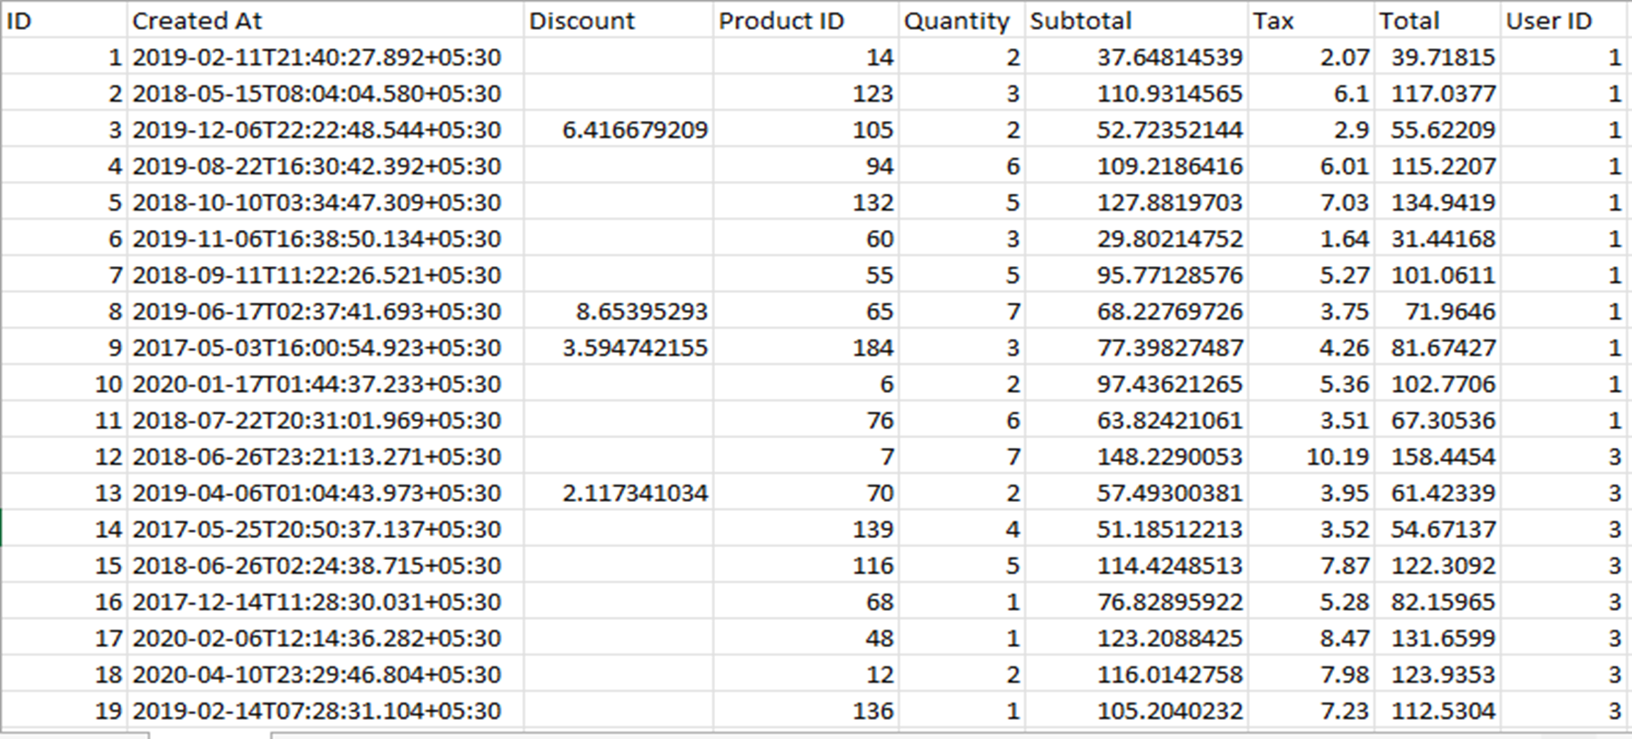
Dataset: orders.csv

Slide 16
Dataset Attributes: products.csv
ID
Category
Created At
EAN (European Article Number)
Price
Rating
Title
Vendor

Slide 17
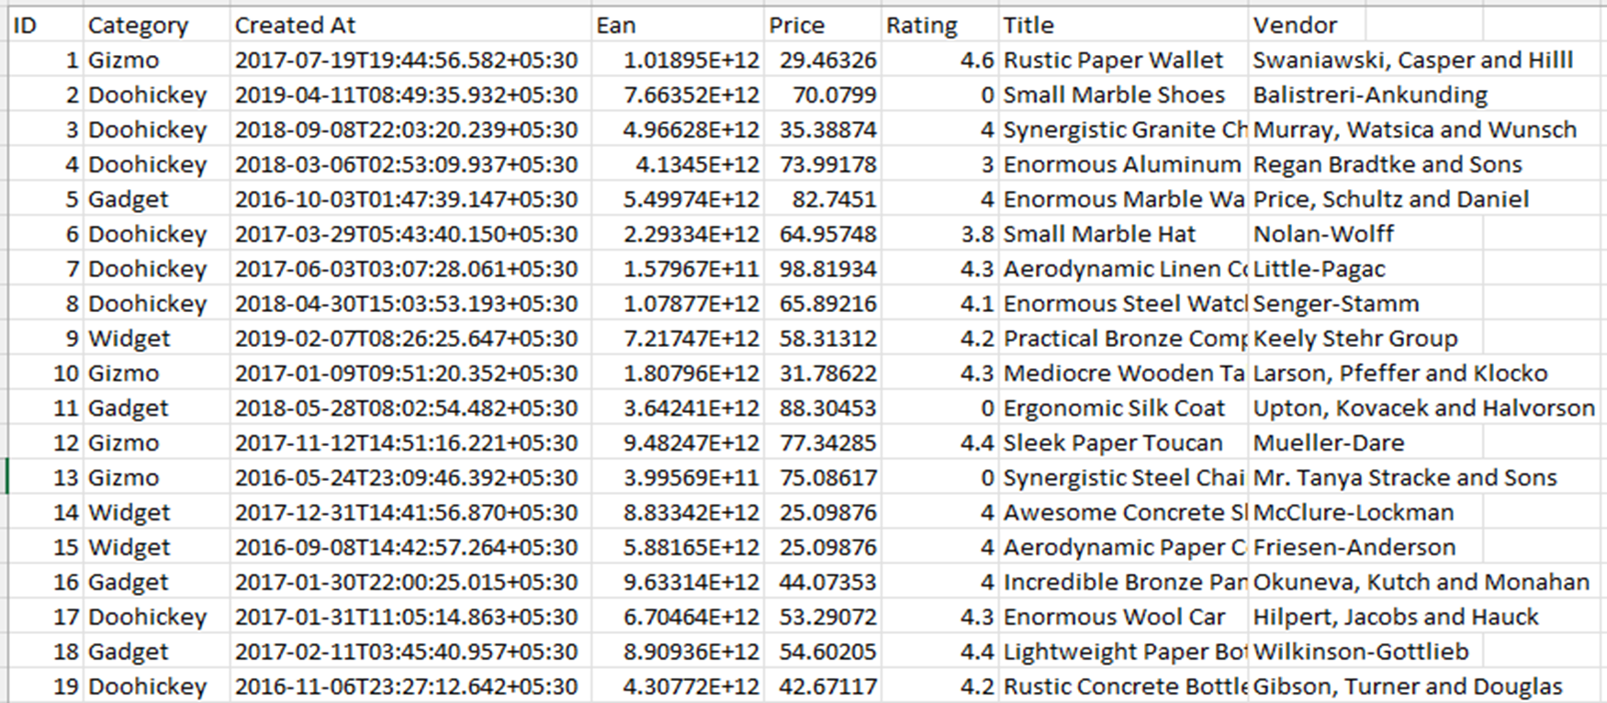
Dataset: products.csv

Slide 18
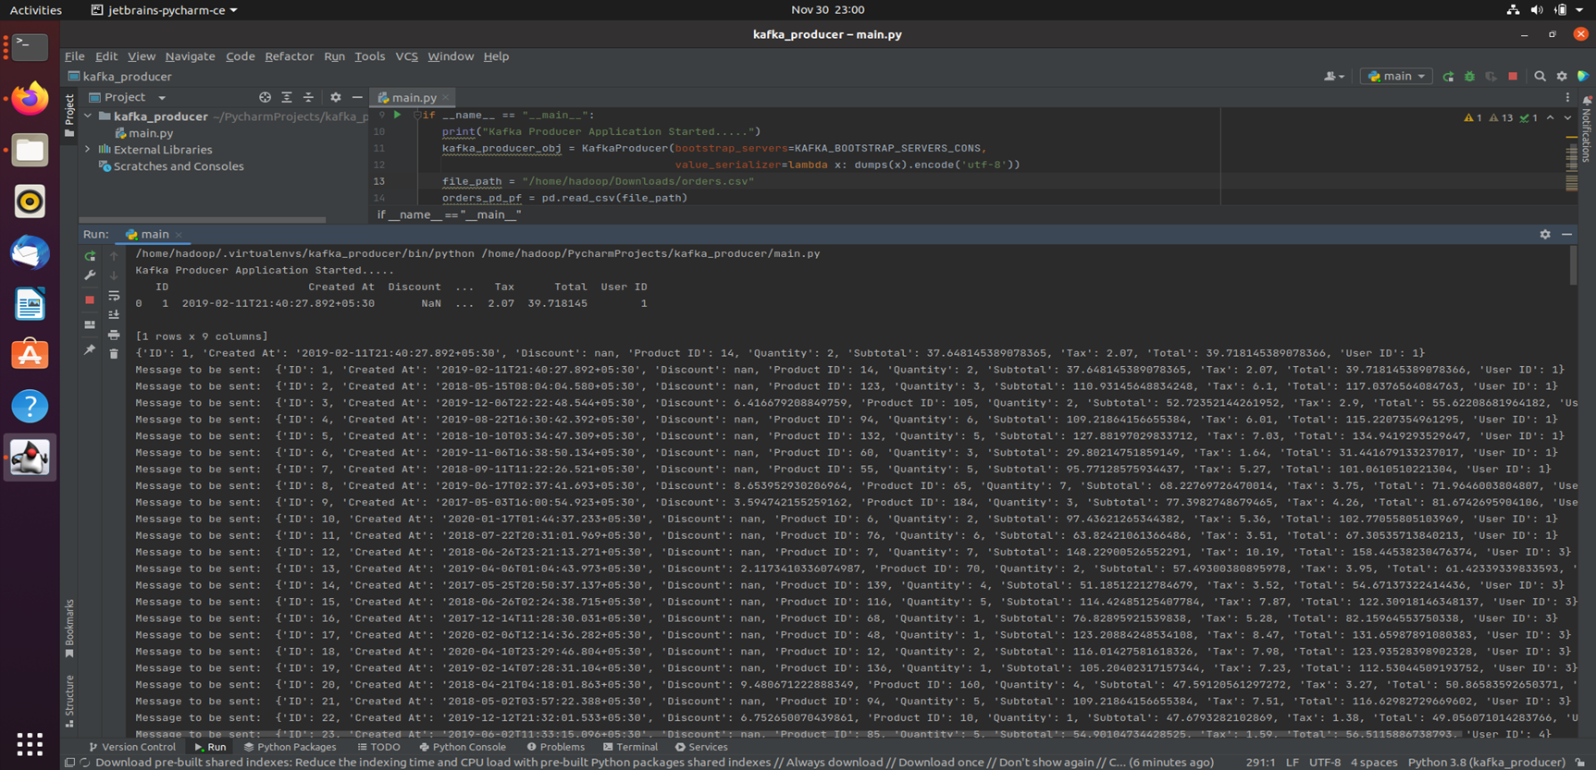
Streaming of Data in Kafka Producer

Slide 19
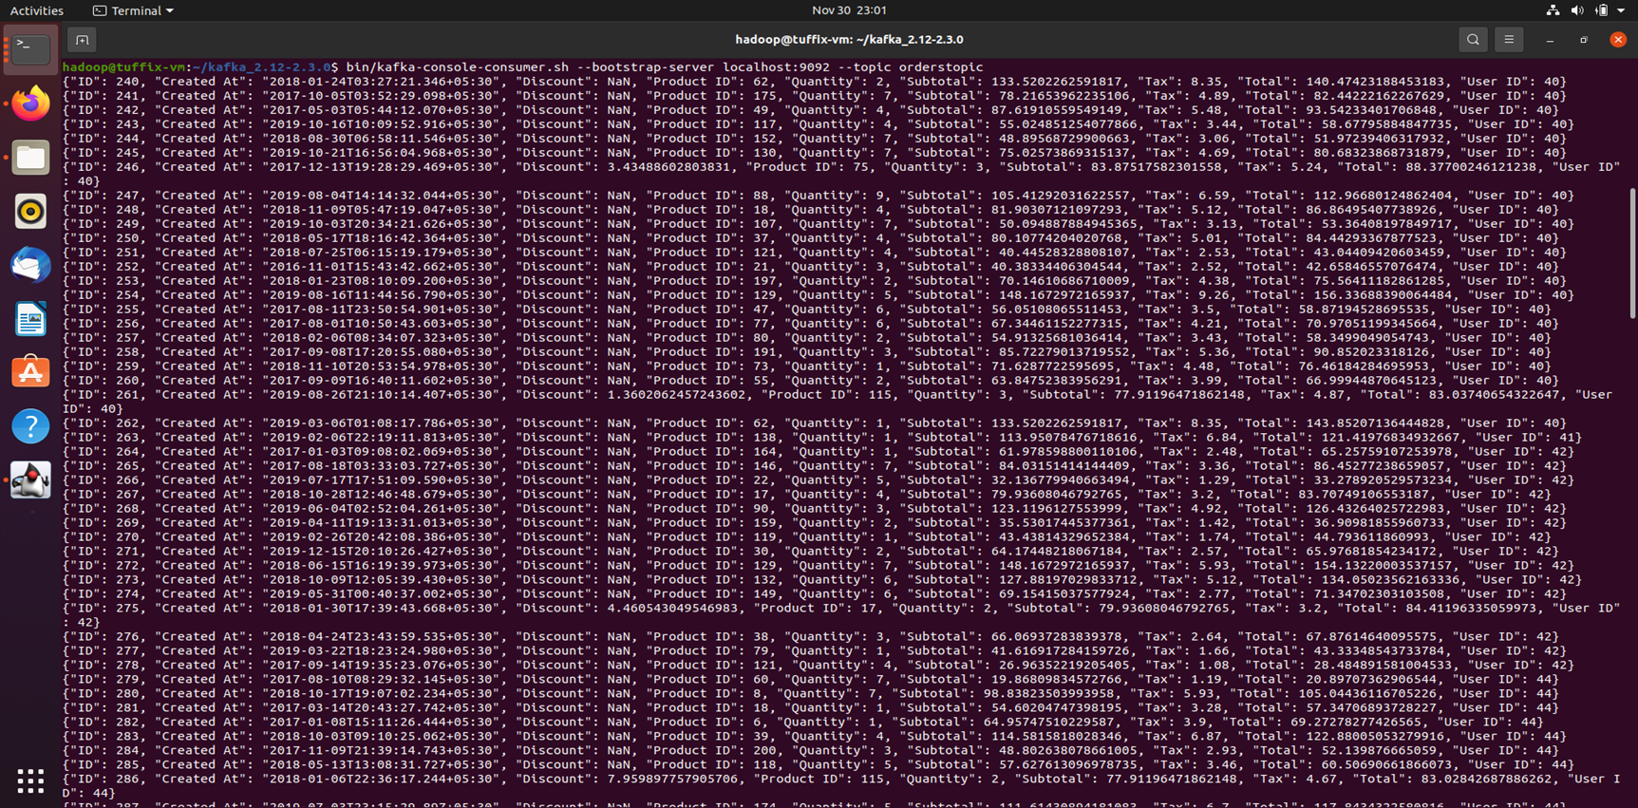
Streaming of Data in Kafka Consumer

Slide 20
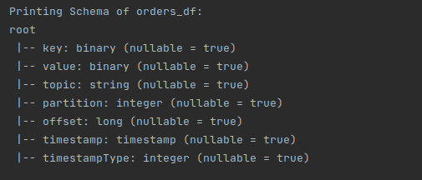
Processing Phase:
Fig: Schema of dataframes generated, of datastream of orders received from kafka-consumer

Slide 21
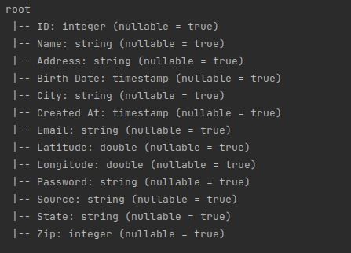
Processing Phase
Fig: Schema of dataframes generated, of static customer data from dataset

Slide 22
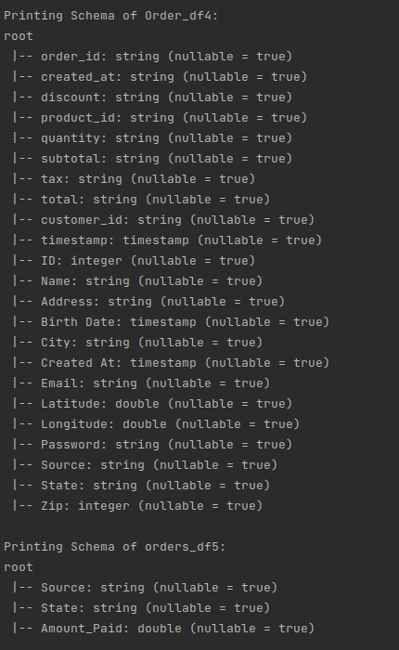
Processing Phase
Fig: Schema of dataframes generated, of forked data of customers and orders used for data analysis

Slide 23
Future Scope
Currently, we have used Cassandra NoSQL data store to store raw data.
As cloud storage becomes more scalable and offers more security, we will be able to employ S3 object storage to develop machine learning models and further complex analytics.

Slide 24
Conclusion
An analysis of the total sales in each state generated by each source will help the e-commerce company choose which marketing platform will maximize their products sale.
Likewise, for the marketing platform, the analysis will aid in increasing their business strategy.

Slide 25
THANK YOU

